Slide 1
The Economics of Prevailing Wage
Frank Manzo IV, M.P.P.
Illinois Economic Policy Institute
Policy Director
Notes:
Good morning!
Now, I actually want to start this presentation with a show of hands. How many of you interact with lawmakers or government bodies in your jobs? [Pause, look around.] How many of you have had to discuss fair contracting and prevailing wage laws with them? [Pause, look around.] And finally, how many of you fully understand the rationale behind the state’s prevailing wage law? [Pause, look around.]
Well, in this presentation I will discuss the economic research on prevailing wage, the positive effects that the research finds, and why prevailing wage is the right choice for Illinois.

Slide 2
What Is Prevailing Wage?
A minimum wage for public works construction projects that reflects local labor market standards for different skilled trades
Based on actual certified payroll records submitted by workers, employers, and interested parties
Protects local construction standards in the competitive public bidding process
Frank Manzo IV - fmanzo@illinoisepi.org /// Illinois Economic Policy Institute – www.illinoisepi.org

Slide 3
The Market is Indifferent
Construction markets work most of the time
The market is amoral – not immoral, not moral
The market doesn’t care who wins or who loses
Public policy and government can intervene when construction markets fail
Frank Manzo IV - fmanzo@illinoisepi.org /// Illinois Economic Policy Institute – www.illinoisepi.org

Slide 4
Public Bidding is Not the Same as Private Construction
Required to select the lowest bidder
Puts pressure on contractors to cut corners
Incentive to slash wages and cut training and benefits in order to win short-term work
Prevailing wage levels the playing field
Frank Manzo IV - fmanzo@illinoisepi.org /// Illinois Economic Policy Institute – www.illinoisepi.org

Slide 5
Prevailing Wage Puts Morality into the Construction Market
Supports middle-class wages
Cares for workers in retirement
Invests in the next generation of workers
Promotes high-quality construction at local market standards
Keeps children safe and ensures their future
Frank Manzo IV - fmanzo@illinoisepi.org /// Illinois Economic Policy Institute – www.illinoisepi.org

Slide 6
Takeaways
Promotes middle-class jobs with good wages
Promotes a skilled workforce that completes jobs right, on-time, the first time
Supports high-quality, durable infrastructure
Strengthens state and local economies
Is the best deal for taxpayers
Frank Manzo IV - fmanzo@illinoisepi.org /// Illinois Economic Policy Institute – www.illinoisepi.org

Slide 7
Prevailing Wage Helps Workers Access Ladders into the Middle Class
Frank Manzo IV - fmanzo@illinoisepi.org /// Illinois Economic Policy Institute – www.illinoisepi.org
Notes:
Here is our first takeaway: Prevailing wage preserves and promotes middle class jobs.

Slide 8
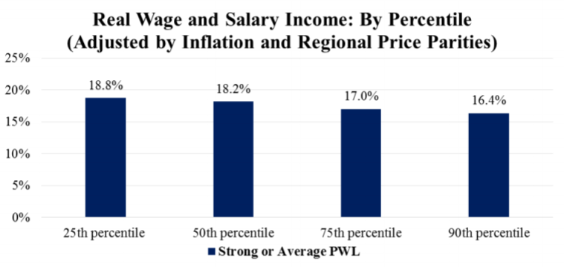
Prevailing Wage Raises Incomes
Frank Manzo IV - fmanzo@illinoisepi.org /// Illinois Economic Policy Institute – www.illinoisepi.org

Slide 9
Prevailing Wage Raises Incomes
Annual construction worker earnings: +17%.
Construction workers with health coverage: +17%
Construction workers with pension: +15%
Construction workers in poverty: -30%
Frank Manzo IV - fmanzo@illinoisepi.org /// Illinois Economic Policy Institute – www.illinoisepi.org

Slide 10
Prevailing Wage Supports the Largest Privately-Financed System of Higher Education in America
Frank Manzo IV - fmanzo@illinoisepi.org /// Illinois Economic Policy Institute – www.illinoisepi.org
Notes:
Through registered apprenticeship programs, the construction industry “operates the largest privately financed system of higher education in the country” (Philips, 2014).
First, another show of hands: Who thinks construction work is low-skilled work that can be done by anyone who can be thrown onto a project on the first day? [Pause, look around.] Alright, who thinks construction requires high-skilled, productive workers? [Pause, look around.] Exactly. WE KNOW that construction requires skilled workers.

Slide 11
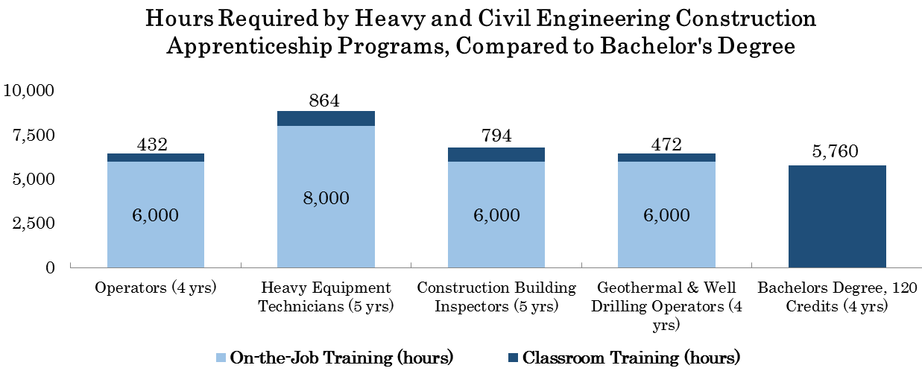
Apprenticeship Training vs. Typical Bachelors Degree
Source: International Union of Operating Engineers Local 150 Assistant Coordinator-Safety Administrator. Local 150 covers counties in Illinois, Indiana, and Iowa.
Frank Manzo IV - fmanzo@illinoisepi.org /// Illinois Economic Policy Institute – www.illinoisepi.org
Notes:
Prevailing wage promotes a skilled workforce. The following is data on training hours required to complete an apprenticeship program for operating engineers in northern Illinois. Occupations are compared to the minimum number of hours required for the typical bachelor’s degree at the University of Illinois. Workers in these apprenticeship programs must complete between 6,400 and about 9,000 hours of classroom and on-the-job training over four or five years. In comparison, the typical bachelor’s degree requires only about 5,800 hours of classroom training. Construction is NOT low-skill work.
The big difference here is that the average cost-of-attendance over four years at the University of Illinois is $78,000 (excluding housing costs). What do apprentices who earn a prevailing wage pay out of pocket over four years? ZERO DOLLARS.
Again, prevailing wage supports registered apprenticeship programs. And through these programs, the construction industry “operates the largest privately financed system of higher education in the country.”

Slide 12
PW Helps Build Careers, Not Just Jobs
States with prevailing wage have significantly more apprentices
Apprentices earn $124,000 more over career
Worker training has fallen by 40% in states that repealed laws
11,000 construction apprentices in Illinois
7th-largest private post-secondary institution in Illinois
Boost the Illinois economy by $1.25 billion annually
Frank Manzo IV - fmanzo@illinoisepi.org /// Illinois Economic Policy Institute – www.illinoisepi.org
Notes:
As a share of total construction workers, states with prevailing wage laws have almost twice as many apprentices. The result is that prevailing wage helps to build lifelong careers, not just seasonal jobs. Over a career, research has shown that estimated earnings of registered apprentices are $124,000 more on average than similar nonparticipants. I call this cradle-to-grave economics… because, again, the policy supports middle class jobs that support families from cradle to grave.
Repeal, of course, has resulted in drops in worker training… with apprenticeships falling by 40 percent in the states that repealed their laws in the ‘80s. YOU WILL SHRINK APPRENTICESHIP TRAINING – AND HENCE SHRINK LIFETIME EARNINGS – BY REPEALING PREVAILING WAGE.

Slide 13
Prevailing Wage Supports High-Quality Infrastructure That is Safe and Durable
Frank Manzo IV - fmanzo@illinoisepi.org /// Illinois Economic Policy Institute – www.illinoisepi.org
Notes:
By financing the skills development of construction workers, prevailing wage increases worker productivity and ensures that workers have the correct knowledge to build high-quality infrastructure that is safe and durable for the American public.

Slide 14
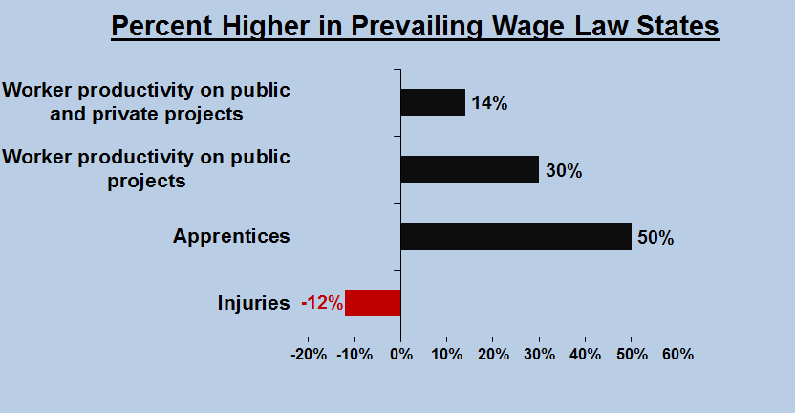
Net Effects: Increase in Productivity
Notes:
On both public and private projects, productivity is 14 percent higher in states with prevailing wage law than in those without a law. Productivity is even higher – 30 percent – on public projects. In addition, on-the-job injuries are 12 percent lower in states with a prevailing wage law, reducing workers’ comp costs as well as saving lives.

Slide 15
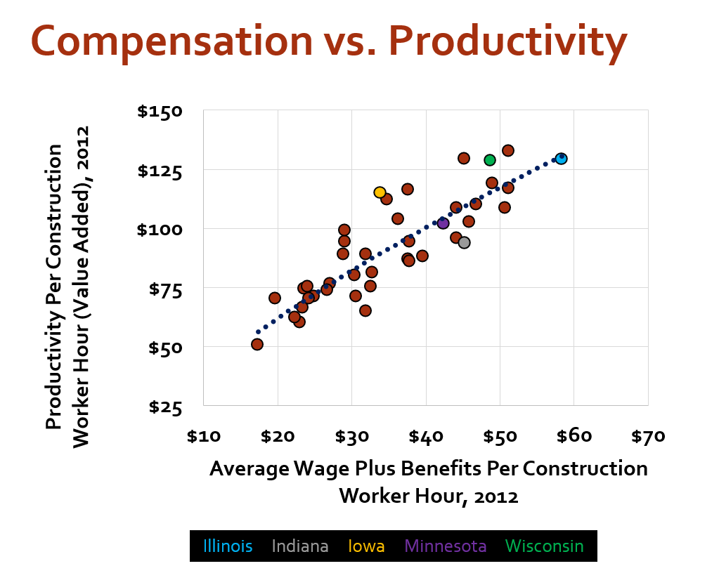
Productive Workers are Paid More
Notes:
On both public and private projects, productivity is 14 percent higher in states with prevailing wage law than in those without a law. Productivity is even higher – 30 percent – on public projects. In addition, on-the-job injuries are 12 percent lower in states with a prevailing wage law, reducing workers’ comp costs as well as saving lives.

Slide 16
Debunks the Cost Myth
Facts: Costs =
Business Cycle +
Regional/Local Market Conditions +
Product Type & Scale
75% of peer-reviewed economic studies find that prevailing wage has no effect on project costs
Frank Manzo IV - fmanzo@illinoisepi.org /// Illinois Economic Policy Institute – www.illinoisepi.org
Notes:
Prevailing wage ensures that jobs are done right, on-time, the first time. The positive impact on productivity offsets any increase in labor costs, and debunks any myth that prevailing wage raises total construction costs. Instead, of course, plenty of other factors raise construction costs: the business cycle, local economic condititions, project type, and project size are all factors that have actually been found to impact construction costs. Prevailing wage laws, on the other hand, have no discernible effect on costs.

Slide 17
Better Infrastructure = Better Economy
Project Bid =
Labor Costs + Quality + Productivity + Materials + Technology + Management Practices + Profit
Frank Manzo IV - fmanzo@illinoisepi.org /// Illinois Economic Policy Institute – www.illinoisepi.org
Notes:
There is no evidence that prevailing wage has any impact. HOWEVER, I did want to have one last slide on why prevailing wage has no effect.
Prevailing wages effectively remove labor costs from the equation for contractors bidding on a public project. They essentially say to firms, “these are the market wages in the community with this project is going to be built… based on certified payrolls submitted by both employers and employees. Pay the market rate, and compete over all these other areas: project quality, your workers’ productivity, materials costs, technological innovation, management practices, and your profit margins.” And firms do compete over these areas, and compete well. Productivity increases, the quality of our public infrastructure improves, and the end result is a better economy.
Prevailing wage prevents a government body from using its expansive purchasing power to undercut privately-established wages and benefits in a community. Prevailing wage forces Big Government to pay a living wage that allows workers to support a family in the community where the project is built.
Prevailing wage is a pro-business policy, because it levels the playing field and weeds out the bad contractors.

Slide 18
Indiana Example
“We got rid of prevailing wage and so far it hasn’t saved a penny. …
The exaggerations in those hearings that we were going save 22%. Well, total labor costs right now in road construction is about 22%, and I haven’t noticed anyone who’s going to work for free. ... There’s not 22% savings out there when the total cost of labor is 22%. It’s rhetoric.”
-Indiana Assistant Majority Leader Ed Soliday [R] on 04/25/17
Frank Manzo IV - fmanzo@illinoisepi.org /// Illinois Economic Policy Institute – www.illinoisepi.org
Notes:
Prevailing wage ensures that jobs are done right, on-time, the first time. The positive impact on productivity offsets any increase in labor costs, and debunks any myth that prevailing wage raises total construction costs. Instead, of course, plenty of other factors raise construction costs: the business cycle, local economic condititions, project type, and project size are all factors that have actually been found to impact construction costs. Prevailing wage laws, on the other hand, have no discernible effect on costs.

Slide 19
Prevailing Wage Strengthens State and Local Economies
Frank Manzo IV - fmanzo@illinoisepi.org /// Illinois Economic Policy Institute – www.illinoisepi.org
Notes:
Alright. Now, everything that I have already mentioned benefits the economy in its own way. Next we will focus on how it all comes together to show that… prevailing wage strengthens state and local economies.

Slide 20
High-Road Economic Development
• Higher quality means higher wages
BUT:
• This increase in wages is the result of an increase in productivity:
-In PWL states, productivity is up to 30% higher on public projects.
Frank Manzo IV - fmanzo@illinoisepi.org /// Illinois Economic Policy Institute – www.illinoisepi.org
Notes:
Yes, construction workers earn slightly more in prevailing wage law states. The research shows that prevailing wages increase wages by somewhere between 2 and 10 percent, and probably closer to 5. BUT… this increase in wage is not because prevailing wages artificially inflate incomes. In fact, it is because workers are more productive. And again, studies show that workers are 8.5 to 33 percent more productive in prevailing wage law states. So workers earn more because the market rewards their increased efficiency.
Look, I’m a huge football fan. And arguing only around wages would be like someone saying that players in the NFL should get paid what players in Canadian football get paid… or what players in the Arena Football League get paid… I mean, they have the same exact occupation! Why pay NFL players an average of $2 million?! Shouldn’t we get rid of the NFL to save on player costs?! Fuck no, you ain’Maybe– and this is just a thought– maybe it’s because they are better skilled and more productive and add more to the regional economy. That’s an aside but it would basically be the same argument.

Slide 21
Jobs, Jobs, Jobs
•Consumer spending ↑ = Job creation ↑
-State prevailing wage laws support 400,000 jobs in the U.S.
•Infrastructure quality ↑ = Job creation ↑
-93% of CEOs say highway accessibility is an important factor
-Every dollar spent on a prevailing wage project generates at least $1.50 in economic activity in the community.
Frank Manzo IV - fmanzo@illinoisepi.org /// Illinois Economic Policy Institute – www.illinoisepi.org
Notes:
With higher wages, workers have more disposable income. Thus, they have more money to spend in the local economy at restaurants, shopping malls, grocery stores, and on property. This supports local employment. So there is an immediate consumer demand component.
By improving infrastructure quality, however, there is also a long-term investment component. Improved infrastructure attracts business. “Highway accessibility,” for example, is 2nd most important factor in determining whether a corporation locates in a state. In the 28th Annual Survey of Corporate Executives, 93.5 percent of CEOs and decisionmakers responded that it was an “important” or “very important” factor. This ranked second only behind “availability of skilled labor” (95.1%). So infrastructure investment attracts firms to a state.
But infrastructure quality generates economic development as well. For every dollar invested in public infrastructure, at least $1.50 is returned in economic activity to a state. Often, this multiplier is even higher, but public projects return at least 50%.

Slide 22
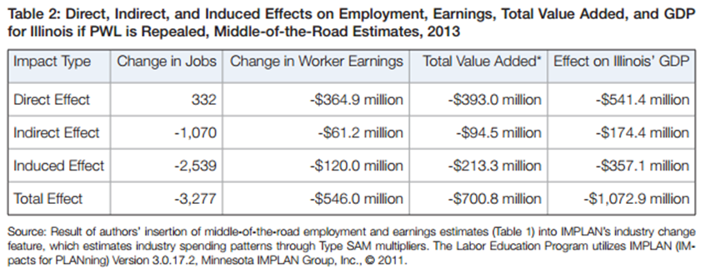
What if Illinois Repealed Prevailing Wage?
Frank Manzo IV - fmanzo@illinoisepi.org /// Illinois Economic Policy Institute – www.illinoisepi.org
Notes:
We use all of the facts on the previous slides in “economic impact analyses” to determine the economic benefits of prevailing wage laws.
Here, we’ll use Illinois as a case study.
In Illinois, the construction industry employs about 200,000 workers in 30,000 businesses. This graph on the screen is from a paper I coauthored with the University of Illinois at Urbana-Champaign on what would happen if prevailing wage was repealed in the state. The key to this chart is highlighted in red, which is the total overall effect of repealing prevailing wage on this state’s economy. Ultimately, repeal would result in an expected 3,300-jobs lost, over half a billion dollars lost in total worker earnings, and a decline of 1.1 billion dollars in the Illinois economy. These are huge impacts for the industry.

Slide 23
If Illinois Repealed Prevailing Wage…
• Lost state and local tax revenues: -$44 million
• Lost federal tax revenues: -$116 million
• Increase in work-related fatalities: +70 deaths over ten years
Frank Manzo IV - fmanzo@illinoisepi.org /// Illinois Economic Policy Institute – www.illinoisepi.org
Notes:
But it’s not just the construction industry that suffers from prevailing wage repeal. As noted earlier, repeal results in reduced consumer spending, which results in job losses throughout the economy. The net effects are that state and local tax revenues would decline by about 45 million dollars, federal tax revenues would fall by over 115 million dollars, and 70 additional workers would suffer work-related construction fatalities over the next ten years. These are 70 women and men we simply do not want to lose. These workers deserve better – and they have it under my state’s prevailing wage law.

Slide 24
Prevailing Wage is the Best Deal for Taxpayers
Frank Manzo IV - fmanzo@illinoisepi.org /// Illinois Economic Policy Institute – www.illinoisepi.org
Notes:
While prevailing wage improves the public budget by increasing tax revenues, it also keeps construction workers off of government assistance. So raising tax revenues… reducing government assistance… and attracting businesses through quality infrastructure, which also improves tax revenues… all of this means that… prevailing wage is the best deal for taxpayers.

Slide 25
Prevailing Wage Reduces Reliance on Public Assistance
• Construction workers on food stamps: -44%
• Construction workers receiving EITC: -8%
• Federal income taxes paid: +$1,057 annually
Frank Manzo IV - fmanzo@illinoisepi.org /// Illinois Economic Policy Institute – www.illinoisepi.org
Notes:
But it’s not just the construction industry that suffers from prevailing wage repeal. As noted earlier, repeal results in reduced consumer spending, which results in job losses throughout the economy. The net effects are that state and local tax revenues would decline by about 45 million dollars, federal tax revenues would fall by over 115 million dollars, and 70 additional workers would suffer work-related construction fatalities over the next ten years. These are 70 women and men we simply do not want to lose. These workers deserve better – and they have it under my state’s prevailing wage law.

Slide 26
The Best Deal for Taxpayers
Prevailing wage raises and compresses wages
More disposable income
More local spending
More sales and income tax revenues
Less income inequality
Less workers in poverty
Less reliance on government assistance programs
Frank Manzo IV - fmanzo@illinoisepi.org /// Illinois Economic Policy Institute – www.illinoisepi.org
Notes:
So, let’s put this all together. Prevailing wage has been found to be the best deal for taxpayers. First, just ignoring what is on the screen for a second, prevailing wage encourages jobs that are done right, on-time, and within budget for the public sector. The infrastructure that is built is of high-quality, it’s durable, and it’s safe. This attracts businesses, which increases local tax revenues.
Second, back to the screen, prevailing wage slightly raises worker. But research shows that prevailing wages have no (positive or negative) impact on the incomes of contractor CEOs or of the highest-paid construction workers. This is because prevailing wages increase the skill-level of workers at the bottom and increases their productivity. Prevailing wage therefore increases and compresses wages.
This has two effects. One is that workers have more disposable income. They spend that in the local economy and the result is more sales and income tax revenues for state and local governments. The other effect is that income inequality is reduced, resulting in fewer workers who are impoverished and less reliance on government assistance programs. By encouraging self-sufficient construction workers and middle-class jobs such that workers can support a family in the community where projects are built, prevailing wage is the best deal for taxpayers.

Slide 27
Prevailing Wage is the Right Choice
Prevailing wage is not a Right-Left issue
Prevailing wage is a Right-Wrong issue
Good jobs vs bad jobs
Stable, skilled careers vs. unstable, low-wage jobs
Stronger economies vs weakened states & cities
High volatility vs stable supply of skilled labor
Frank Manzo IV - fmanzo@illinoisepi.org /// Illinois Economic Policy Institute – www.illinoisepi.org
Notes:
Read slide.

Slide 28
Remember, Remember…
Promotes middle-class jobs with good wages
Promotes a skilled workforce that completes jobs right, on-time, the first time
Supports high-quality, durable infrastructure
Strengthens state and local economies
Is the best deal for taxpayers
Frank Manzo IV - fmanzo@illinoisepi.org /// Illinois Economic Policy Institute – www.illinoisepi.org

Slide 29
Contact
Illinois Economic Policy Institute (ILEPI) social media:
www.illinoisepi.org
Twitter: https://twitter.com/IllinoisEPI
Facebook: https://www.facebook.com/IllinoisEPI/
Frank Manzo IV - fmanzo@illinoisepi.org /// Illinois Economic Policy Institute – www.illinoisepi.org

